Slide 1

Privatization in Banking Sector

Slide 2
Group-3 Members
Aneri Sheth – 1401072
Hemil Gurjar – 1401002
Himanshu Budhia – 1401039
Janki Desai – 1401103
Kunal Suba – 1401097
Palash Hariyani – 1401101
Rajvi Prajapati – 1401033
Rupande Shastri - 1401102

Slide 3
Table of Contents
Introduction
Privatization : A snapshot
Methods of Privatization
Why Privatization?
The Indian Banking Sector: A snapshot
Old and New Private Sector Banks
RBI Guidelines for Private Sector Banks
Effect of new Private Sector Banks on PSB’s
Impacts of Privatization
Adverse Impacts of Privatization
Conclusion

Slide 4
Introduction
In this event of globalization that took place in India decades back, privatization has become an order of the day
In simple terms, privatization is the transfer of ownership and control of public sector units to private sector companies or individuals
Considering the banking sector in India, privatization has led to emergence of private sector banks where the greater part of the finance or equity are held by private stakeholders and not by the government
Private sector banks can be split into two further types – old and new private sector banks. This has led to an impact on Indian Economy and has lifted the Indian Banking Sector as a whole

Slide 5
Privatization: A snapshot
Privatization has been used to describe two unrelated transactions: The first is the buying of all outstanding shares of a publicly traded company by a single entity, making the company privately owned. This is often described as private equity and the second is a demutualization of a mutual organization or cooperative to form a joint-stock company
Privatization may also mean the government outsourcing of services or functions to private firms, e.g. revenue collection, law enforcement, and prison management

Slide 6
Methods of Privatization
There are four main methods of privatization:
Share issue privatization (sip) - selling shares on the stock market
Asset sale privatization - selling an entire organization (or part of it) to a strategic investor, usually by auction
Voucher privatization - distributing shares of ownership to all citizens, usually for free or at a very low price
Privatization from below - Start-up of new private businesses in formerly socialist countries.

Slide 7
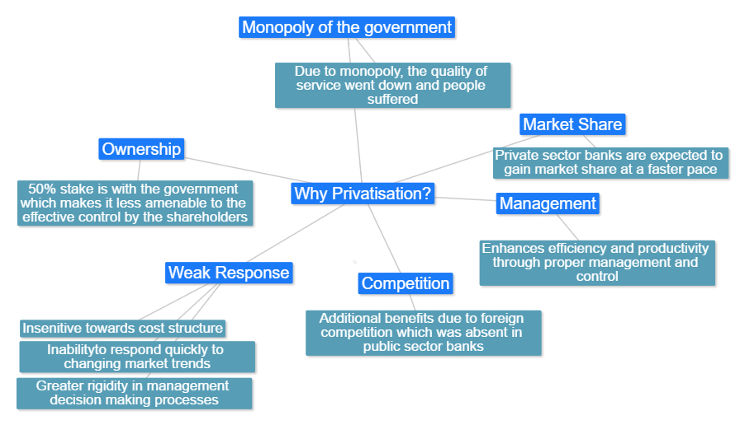
Why Privatization?

Slide 8
The Indian Banking Sector: A snapshot
India is the largest country in South Asia with a huge financial systems characterized by variety of institutions and instruments. The Indian financial sector was well developed even before political independence of the country in 1947. The first bank in India, though conservative was established in 1786 (General Bank of India was the first joint stock bank)
In the first half of the 19th century, the East India Company, established three bank: the Bank of Bengal in 1809, the Bank of Bombay in 1804 and Bank of Madras in 1843. These three banks were amalgamated in 1920 and the Imperial Bank of India was established on Jan 27, 1921

Slide 9
Indian Banking Sector (contd.)
With the passing of the SBI Act in 1955, the Imperial Bank of India was taken over by the newly constituted SBI. The Reserve Bank, which is the Central Bank, was created in 1935 by passing the Reserve Bank of India act 1934
In the wake of the Swadeshi Movement, two successive nationalization of banks taken on July 19, 1969, 14 major banks of the country were nationalized and on April 15, 1980, 6 more commercial private sector banks were also taken over by the government
The present commercial banking system in India may be distinguished into public sector banks, private sector banks, and foreign banks
According to Ministry of Finance, there are 20 Private Sector Banks operational in India. These include 13 old private sector banks and 7 new private sector banks

Slide 10
Old Private Sector Banks
Banking in India has been dominated by public sector banks since the 1969 when all major banks were nationalised by the Indian government. However, since liberalisation in government banking policy in the 1990s, old and new private sector banks have re-emerged. They have grown faster & bigger over the two decades since liberalisation using the latest technology, providing contemporary innovations and monetary tools and techniques
The banks, which were not nationalized at the time of bank nationalization that took place during 1969 and 1980 are known to be the old private-sector banks. These were not nationalized, because of their small size and regional focus

Slide 11
Most of the old private-sector banks are closely held by certain communities their operations are mostly restricted to the areas in and around their place of origin. Their Board of directors mainly consist of locally prominent personalities from trade and business circles
One of the positive points of these banks is that, they lean heavily on service and technology and as such, they are likely to attract more business in days to come with the restructuring of the industry round the corner

Slide 12
Some Old Private Sector Banks of India
Bank of Rajasthan Ltd.
Catholic Syrian Bank Ltd.
City Union Bank Ltd.
Dhanalakshmi Bank Ltd.
Federal Bank Ltd.
ING Vysya Bank Ltd.
Jammu and Kashmir Bank Ltd.
Karnataka Bank Ltd.
Karur Vysya Bank Ltd.
Lakshmi Vilas Bank Ltd., etc.

Slide 13
New Private Sector Banks
The banks, which came in operation after 1991, with the introduction of economic reforms and financial sector reforms are called "new private-sector banks". Banking regulation Act was then amended in 1993, which permitted the entry of new private-sector banks in the Indian banking sector
However, there were certain criteria set for the establishment of the new private-sector banks, some of those criteria being:
The bank should have a minimum net worth of 200 crores INR.
The promoters holding should be a minimum of 25% of the paid-up capital.
Within 3 years of the starting of the operations, the bank should offer shares to public and their net worth must increased to 300 crores

Slide 14
RBI Guidelines for New Private Sector Banks
As part of reforms process in the financial services sector, the R.B.I. issued in January 1993 guidelines for licensing of new banks in the private sector. After 8 years it has revised its guidelines in January 2001.
PAID-UP-CAPITAL:
The initial minimum paid up capital for a new bank would be Rs.100 crores. The initial capital should be raised to Rs.300 crores within 3 years of commencement of business
The overall capital structure of the proposed bank would have to be approved by the RBI
PROMOTERS CONTRIBUTION:
The promoters’ contribution will be a maximum of 40% of paid up capital of the bank at any point of time. The initial capital, other than the promoters’ contribution can be raised through public issue (or) private placement
The Promoters contribution of 40% will be locked in for 5 years from the date of licensing of the bank. Similar conditions would apply within 3 years of commencement of business

Slide 15
FOREIGN INVESTMENT:
Non-resident Indian participation in the primary equity of a new bank will be to a maximum extent of 40%
In case of foreign banking (or) finance acting as a technical collaborator (or) Co-promoter, equity participation will be restricted to 20% within the above ceiling of 40%
In case of shortfall of foreign equity contribution of NRI’s then multilateral institutions would be allowed to contribute foreign equity to the extent of shortfall in NRI contribution of the equity. The necessary approval of FIPB should also be obtained
BANKS PROMOTED BY LARGE INDUSTRIAL HOUSES:
A large industrial house will not be allowed to promote new banks
However individual companies, directly (or) in directly connected with new banks can be permitted to participate in the equity of bank up to 10% limit and this is applied to all interconnected companies of large business house.
CAPITAL ADEQUACY REDQUIREDMENTS:
The bank will be required to maintain a minimum capital adequacy ratio of 10% on a continuous basis from the commencement of its operation.

Slide 16
Some New Private Sector Banks of India
Axis Bank(earlier UTI Bank)
Bank of Punjab(actually an old generation private bank since it was not founded under post-1993 new bank licensing regime)
Centurion Bank Ltd. (Merged Bank of Punjab in late 2005 to become Centurion Bank of Punjab, acquired by HDFC Bank Ltd. in 2008)
ICICI Bank (previously ICICI and then both merged; total merger SCICI+ICICI+ICICI Bank Ltd)
YES Bank
IndusInd Bank
Kotak Mahindra Bank
HDFC Bank
IDFC Bank, etc.

Slide 17
Effect of Private sector banks on PSB’s
In 1995-96, the share of old private sector banks in total assets was 6.2 per cent while that of new private sector banks was 1.4 per cent
The Private sector banks had improved their market share to 5.3 per cent by 1999-2000 with comparison to the Public sector banks
The share of private sector banks in the total number of branches in 1992-93 was only 8.33 percent
In 2002-03, the share of private sector banks in total bank branches is 8.75 per cent

Slide 18
Network of Banks
Today banks follow a strategy of building a network of branches and ATMs with effective penetration so that they can continue to enlarge their geographical coverage with a greater potential for growth. The banks try to deeply entrench across the country with significant density in areas conducive to the growth of their businesses
The private sector banks have expanded themselves at a much faster rate than public sector banks. The customer base of these banks has grown manifold since they are able to provide innovative services to the customers at a much faster pace. This is helping them to capture a higher market share and depleting some of the share of the public sector counterparts

Slide 19
Productivity
In the banking scenario productivity can be measured by profit per employee, business per employee. Productivity is a very important measure of efficiency of banks because it means that the firm can meet its obligations to employees, shareholders, and governments (taxes and regulation), and still remain competitive in the market place
These ratios can be misleading as banks can improve these ratios by reducing their number of their employees during the time of recession. This is evident since asset base and profit levels declined during 2009-10 for new private sector banks but still the above ratios is showing a continuous increasing trend

Slide 20
Cash Adequacy Ratio (CAR)
Capital Adequacy Ratio (CAR) is the ratio of a bank's capital in relation to its risk weighted assets and current liabilities
The Capital Adequacy ratio (BASEL-II) of new private sector banks is way above RBI’s minimum requirement of 9%.
This shows that private banks are in comfortable position to absorb losses since they have more capital to cover for their risk weighted assets and they have less risky assets in their portfolio for a fixed capital base

Slide 21
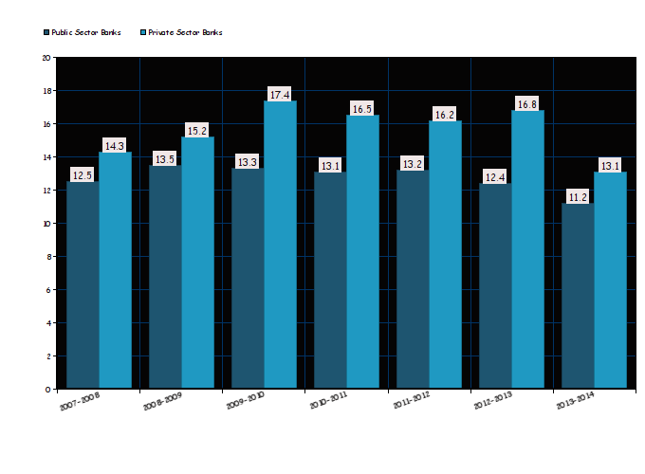
Graph showing Capital Adequacy Ratio

Slide 22
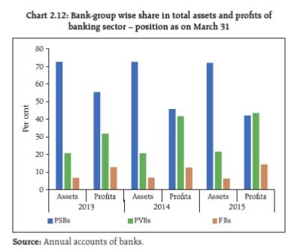
Growth of Banks
Every bank aspires to grow and its growth can be judged by various parameters like growth in balance sheet size i.e. asset base, total income and many others

Slide 23
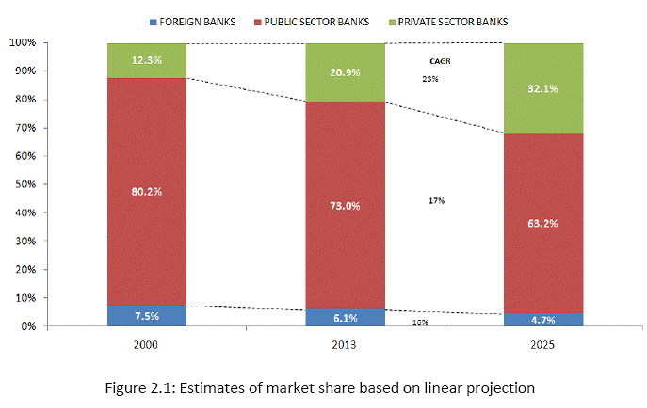
Predicting a linear growth based on the current growth rate

Slide 24
Efficiency of Management
Several indicators are used to measure the efficiency of the management for example ratio of non-interest expenses to total assets which explains the management controls on operating expenses. Similarly efficiency ratios like Asset Turnover ratio can be used to assess how efficiently company is using its assets to earn the revenue
The efficiency ratios of new private sector banks are better than public sector banks which eventually lead to enhanced bottom line. The asset turnover of both sectors banks is decreasing over the last 3 years which is mainly due to a combination of decrease in non-interest income and increase in asset base
Most of the new private sector banks have shown better performance than their public sector counterparts

Slide 25
Top 5 Emerged Private Sector Banks of India(2014-15)
Private Sector Banks | Year, Founder | Revenue | Total Assets | Net Income
HDFC Bank | 1994 Hasmukhbhai Parekh | 99.41 billion INR | 6.879 trillion INR | 33.57 billion INR
ICICI Bank | 1994, Industrial Credit and Investment Corporation of India | 13 billion USD |  | 1.8 billion USD
Axis Bank | 1994 | 445.6 billion INR | 4.672 trillion INR | 74.48billion INR
Kotak Mahindra Bank | 2003, Uday Kotak | 109.6 billion INR |  | 15.69 billion INR
IndusInd Bank | 1994, Hinduja Group is the parent organization | 82.5 billion INR

Slide 26
Impacts of Privatization
There was a great increase in the number of bank branches after privatization from 8262 to 45,898 nationwide
Branches in rural/semi-urban sectors increased from 2% to 40% after the privatization phase
Credits in agriculture increased from Rs.162 crore to Rs.4,46,496 crore
More job opportunities after privatization which leads to increase in staff from 2,20,000 to 9,65,720

Slide 27
Because of credit misallocation, public sector banks may be a bigger threat to stability than private banks
Private sector bank loans growth is faster as compared to public sector banks
There was a great increase in the efficiency of the private banks as the control over bank employees increases
Private sector banks provide many additional services to its customers to rise in competition

Slide 28
Adverse Impacts of Privatization
Interest rates are higher in private banks than in public banks
Private banks contribute to the global and nationwide recession
Private banks tend to be biased towards the more profitable sectors, hereby widening the gap between rich and poor
There is less job security in case of private banks
Interference and manipulation by the politician and industrialist is in full swing. In some cases, bank loans were used to garner votes
Due to minimal government control, private banks are free to use private recovering agencies to recover bad loans

Slide 29
Conclusion
Based on the current statistics, Privatization shows no signs of receding in the next decade
Privatization has an overall positive impact in the economy, with a few adverse impacts
Nationwide debate over Privatization has made it influential in various sectors including banking, industries etc.
The influence of privatization is seen more in developed areas. However, it still needs to develop in rural areas
Not only the customers are benefitted, but privatization in banking sector has overall uplifted the economic growth and development

Slide 30
The advent of Liberalization, globalization and privatization has paved the way for the entry of more number of private and global players in almost all the economic activities of the country and banking sector is not an exception to this
We examined the areas of banking business of old private sector banks that may have been influenced by the new generation private sector banks
The impact of the arrival of new private sector banks on the performance of the old private sector banks based on parameters such as Growth, Credit Quality, Operational Efficiency, and Profitability etc. has been analysed

Slide 31
All latest technologies, professionalism, innovative product and services etc. have set in dramatic changes. Old private sector banks started declaring losses and experiencing the need for total change in their working and preparing to face stiff competition from the new private players
major area of concern for any bank is the customer service and customer satisfaction, thus just like the private sector banks, it is high time that the public sector banks also start concentrating more on the customers and the services provided to them
Top most rank held by a private bank is a clear indicator of the better performance of the private banks due to their higher concern towards customer feedback, their efficient management and thus yielding to higher productivity and networks throughout India

Slide 32
Thank You

